Slide 1


FULL STACK DEVELOPER
PRESENTATION BY MEHUL KANANI

Slide 2
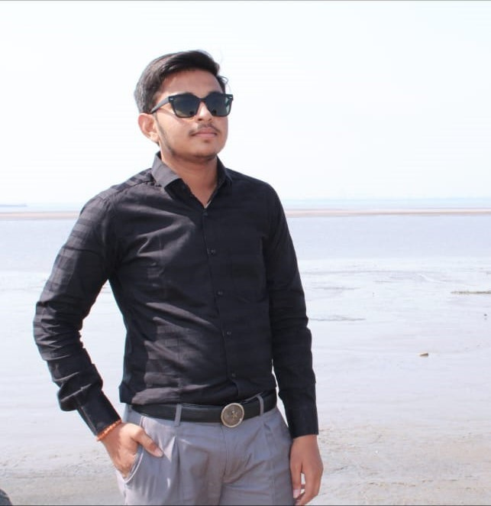
About Me
SDJ International Collage(2024)
Creative design & Multimedia
Institute (Learning)
Internship (March)
Kalathiya Infotech(Current Working)

Slide 3
Skills
Front-End Development
Proficient in HTML5, CSS3, and JavaScript (ES6+).
Expertise in front-end frameworks like React, Angular, or Vue.js.
Experience with responsive design using frameworks like Bootstrap or Tailwind CSS.
Knowledge of modern UI/UX design principles and tools (e.g., Figma, Adobe XD).
Skilled in implementing single-page applications (SPAs).

Slide 4
Skills
Back-End Development
Proficient in server-side languages such as Node.js .
Expertise in frameworks like Express.js,MongoDb
Skilled in creating and managing RESTful and GraphQL APIs.
Experience with authentication and authorization using JWT, OAuth.

Slide 5

Experience
Kalathiya Infotech
At Kalathiya Infotech, I contributed to the development of dynamic web and mobile applications as a Full-Stack Developer. My role involved designing responsive front-end interfaces, building robust back-end solutions, and integrating APIs to deliver seamless user experiences. I collaborated with cross-functional teams to ensure timely project delivery and high-quality results.

Slide 6
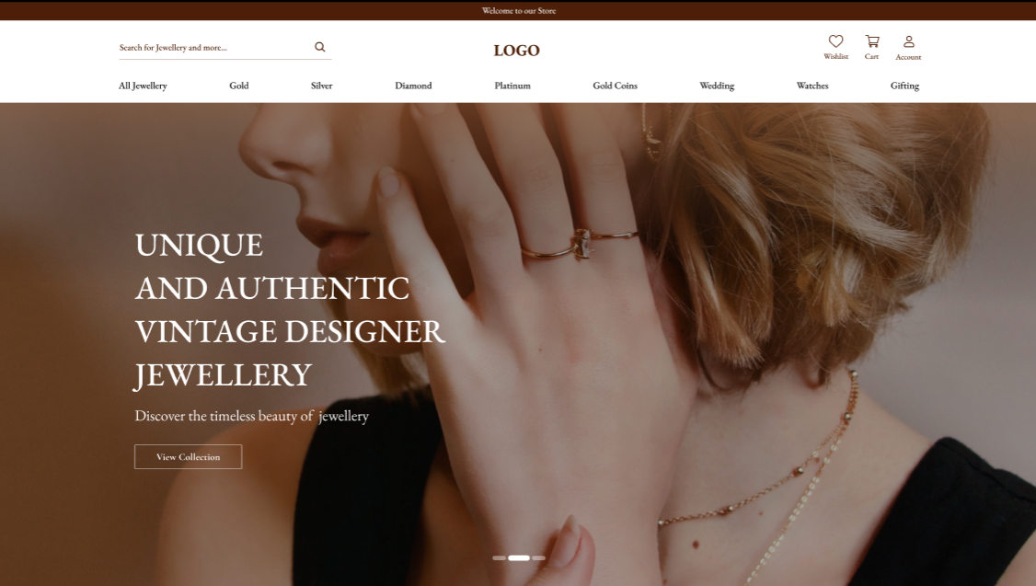
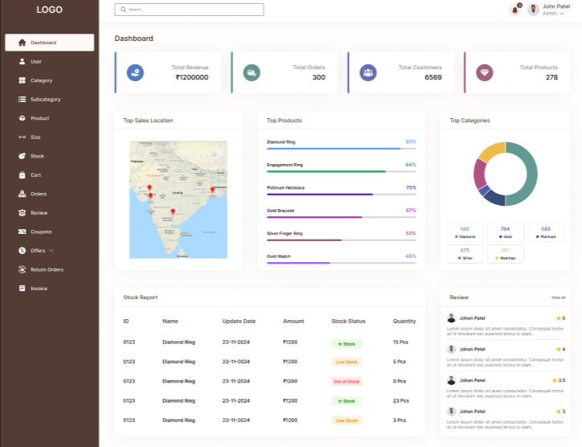
Jewellery
Designed and developed an elegant jewelry e-commerce platform with features like product browsing, advanced search, and a personalized wishlist. Integrated a secure payment gateway and implemented a robust admin panel for managing inventory and orders. Ensured a responsive design to deliver a seamless shopping experience across devices.

Slide 7
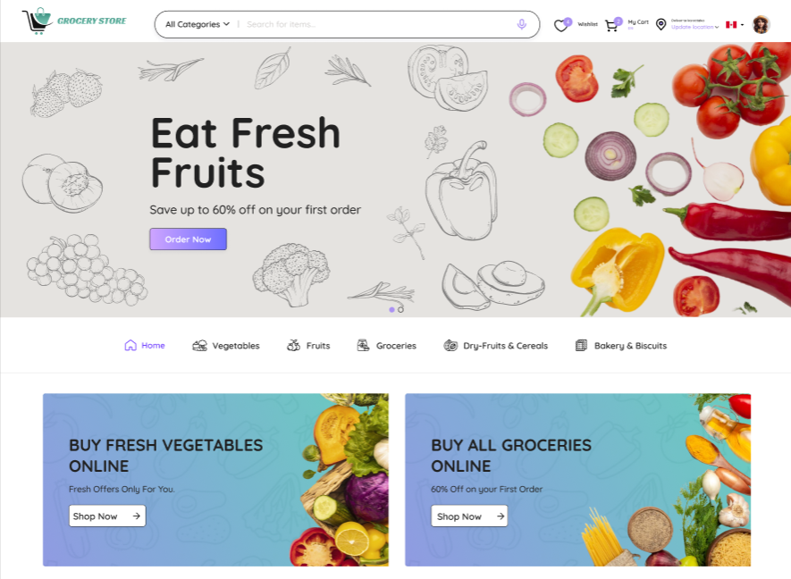
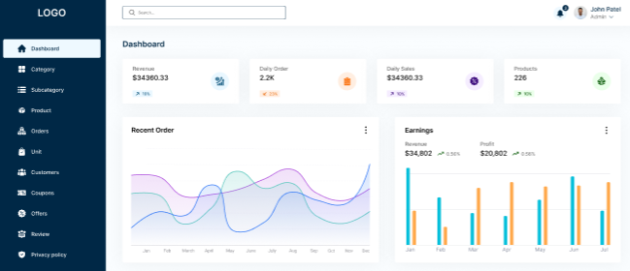
Grocery
Developed a feature-rich grocery admin panel for efficient inventory management, order tracking, and user management. Integrated real-time analytics and reporting tools to monitor sales and stock levels. Designed a user-friendly interface to simplify workflows and enhance operational efficiency.

Slide 8





Contact Us
+91 6352 800 647
https://mkanani.netlify.com
mkanani556@gmail.com
Surat, Gujarat

Slide 9
Thank You

